Slide 1
FACULTY OF ENGINEERING
DEPARTMENT OF
ELECTRICAL & ELECTRONICS ENGINEERING
SMART DOOR LOCK SYSTEM USING FACE RECOGNITION
Graduation Project Ozan Emre Tunca - 2000003058 Kemal Can Güngör - 2000004381
Supervisor: Öğr. Gör. BASRİ ERDOĞAN
June 2025

Slide 2
Contents
Abstract
Aim of the Project
Materials
System Overview
Face Detection Methods
Face Recognition Process
Liveness Detection

Slide 3
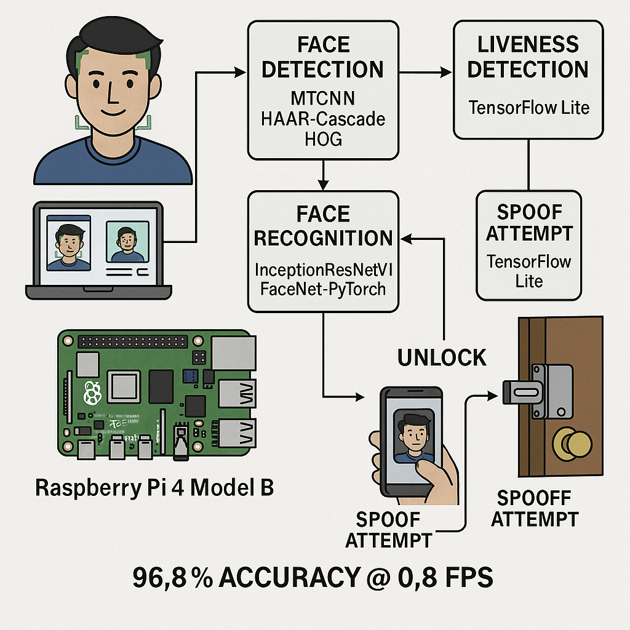
Abstract
This project presents a smart door lock system that operates on a Raspberry Pi 4 Model B, incorporating deep learning–based face recognition and liveness detection.
The system utilizes the MTCNN algorithm to accurately detect faces under various conditions, while HAAR-Cascade and HOG methods are employed to reduce computational load. Facial verification is conducted using the InceptionResNetV1 model via the FaceNet-PyTorch library, and spoof attempts are mitigated using a TensorFlow Lite–based liveness detector capable of identifying photo and video attacks.
When a recognized face is detected, the system sends an unlock command to the solenoid lock; otherwise, the lock remains closed. The system achieves a recognition accuracy of approximately 96.8% at 0.8 FPS, offering a secure and cost-effective solution for access control.

Slide 4
Aim of the Project
🔍 Objective | 🧠 Description
👁️‍🗨️ Face Recognition-Based Access | Automatically unlocks the door by recognizing registered users’ faces.
🧠 Liveness Detection | Prevents spoofing attacks by detecting fake entries (photos, videos, screens).
🧩 Real-Time Embedded Operation | Runs entirely on Raspberry Pi 4 without needing external servers.
🔐 Data Privacy & Local Processing | All user data is stored locally, ensuring full compliance with privacy laws.
📈 High Accuracy with Low Cost | Offers a cost-effective solution with performance comparable to commercial systems.

Slide 5
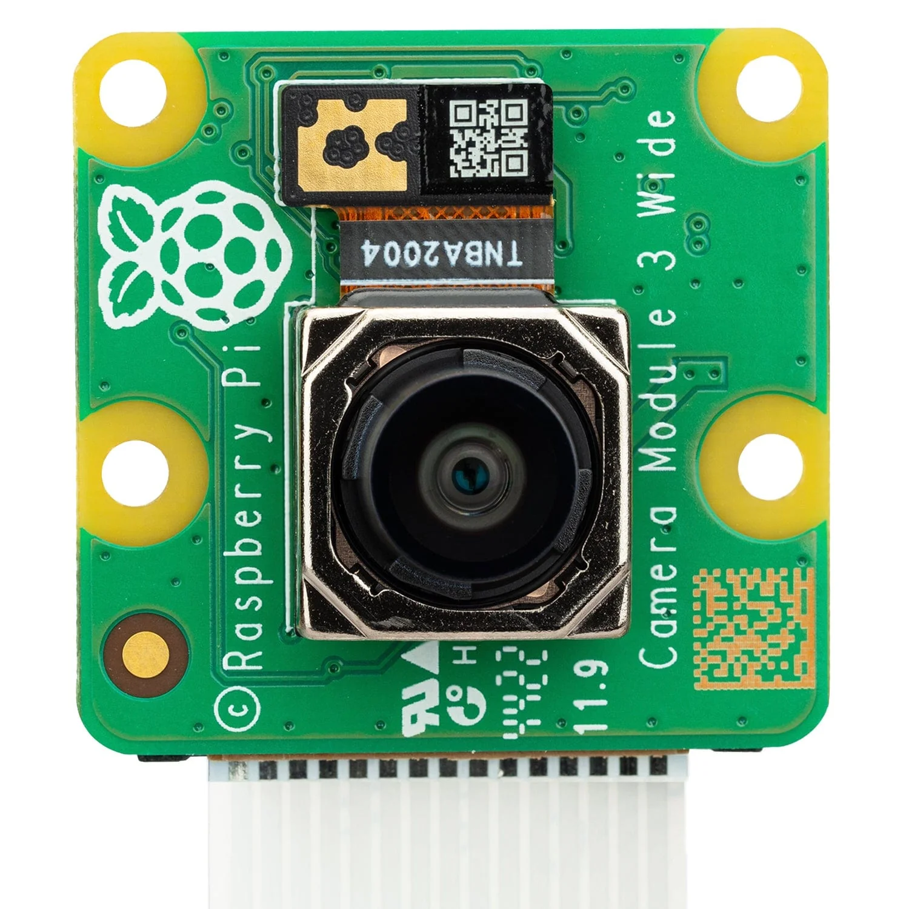
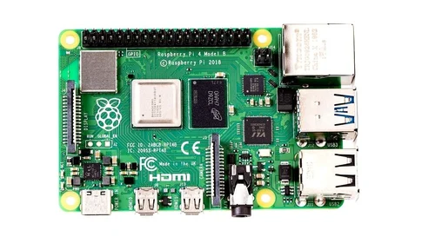

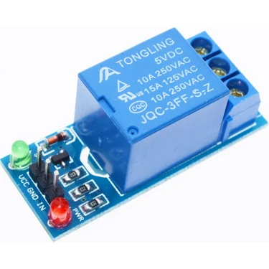
Materials
In this project, a set of compact and cost-effective hardware components was selected to support real-time face detection, recognition, and door control operations on an embedded platform. Below are the key elements used in the system:
Raspberry Pi 4 | Main processing unit; handles all operations
Pi Camera Module V3 | Captures live video stream for face input
5V Relay Module | Acts as a digital switch for the door lock
Solenoid Door Lock | Locks/unlocks physically when triggered

Slide 6
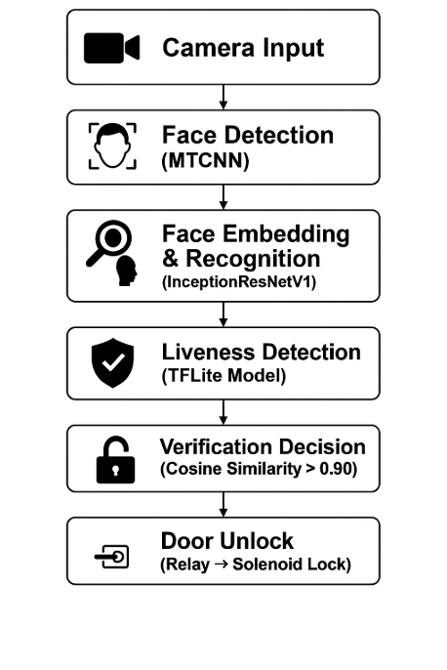
System Overview
The smart door lock system consists of multiple interconnected modules working in harmony.
The flow begins with capturing the face image via camera, followed by face detection, recognition, liveness verification, and door control—all handled in real time on a Raspberry Pi.

Slide 7
Face Detection Methods
In this project, we evaluated several face detection methods to identify the most suitable one for real-time, embedded, and security-critical applications.
Haar Cascade, one of the earliest and most widely used traditional face detection algorithms, is based on the Viola–Jones method. It is lightweight and fast, making it suitable for low-power devices. However, it struggles with non-frontal faces, varied lighting conditions, and complex backgrounds, which are common in real-world environments.
HOG (Histogram of Oriented Gradients), typically combined with a linear SVM classifier, offers better accuracy than Haar Cascade, especially when faces are properly aligned and well-lit. Nevertheless, it still depends on hand-crafted features and performs poorly when the angle or position of the face deviates significantly from the training set.
After extensive testing, we adopted MTCNN (Multi-task Cascaded Convolutional Neural Network) for our system. As a deep learning–based approach, MTCNN offers superior accuracy, robustness to facial angles, and lighting variations. It not only detects the face but also provides facial landmarks (such as eyes, nose, mouth), which are essential for precise embedding extraction in recognition models. Although it runs slightly slower than traditional methods, its overall performance in terms of reliability and detection quality makes it ideal for our project.

Slide 8
Face Recognition Process
After detecting a face, the system extracts a 512-dimensional embedding using the InceptionResNetV1 model. This embedding uniquely represents the person’s face.
During verification, the system compares the live embedding with stored ones using cosine similarity. If the similarity is above 0.90, the person is recognized and access is granted.
This method allows:
Fast and accurate recognition
Local processing without internet
Tolerance to small changes in appearance

Slide 9
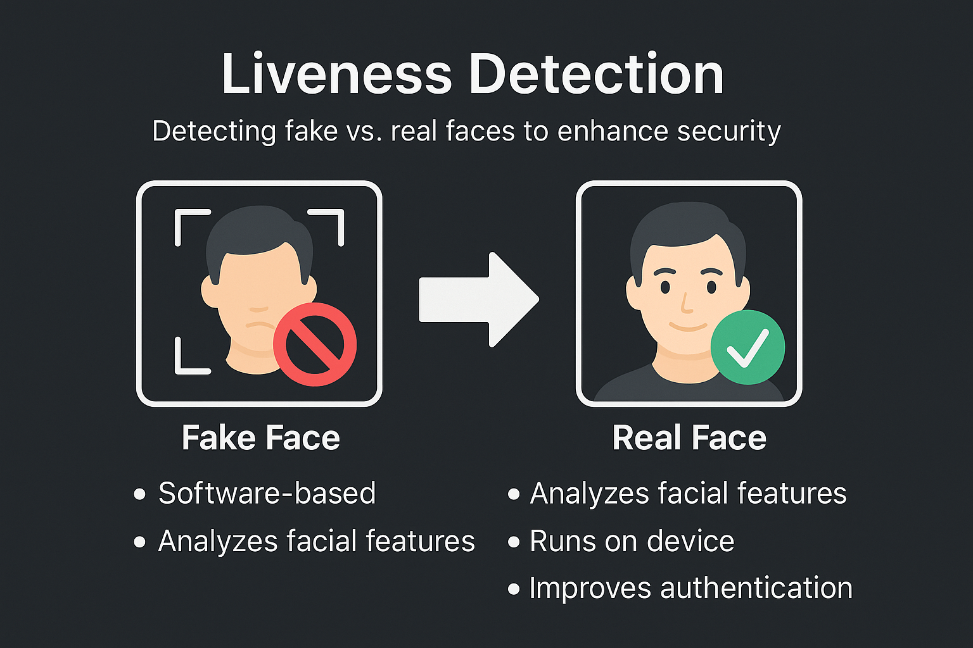
Liveness Detection
To prevent unauthorized access using photos, videos, or screens, our system incorporates a software-based liveness detection module.
This lightweight model, implemented using TensorFlow Lite, analyzes subtle cues in a live face—such as texture quality, depth inconsistencies, and natural motion—to determine whether the face is real or spoofed.
Unlike hardware-based solutions (e.g., IR or 3D sensors), this approach works entirely on the Raspberry Pi, without additional cost or components.
Key Benefits:
✅ Detects spoof attempts (photo, video, printed mask)
⚙️ Requires no extra hardware
💻 Runs locally, in real time
🔒 Ensures only real, live users are authenticated
With a success rate of over 96%, this module significantly strengthens the system’s security.

Slide 10
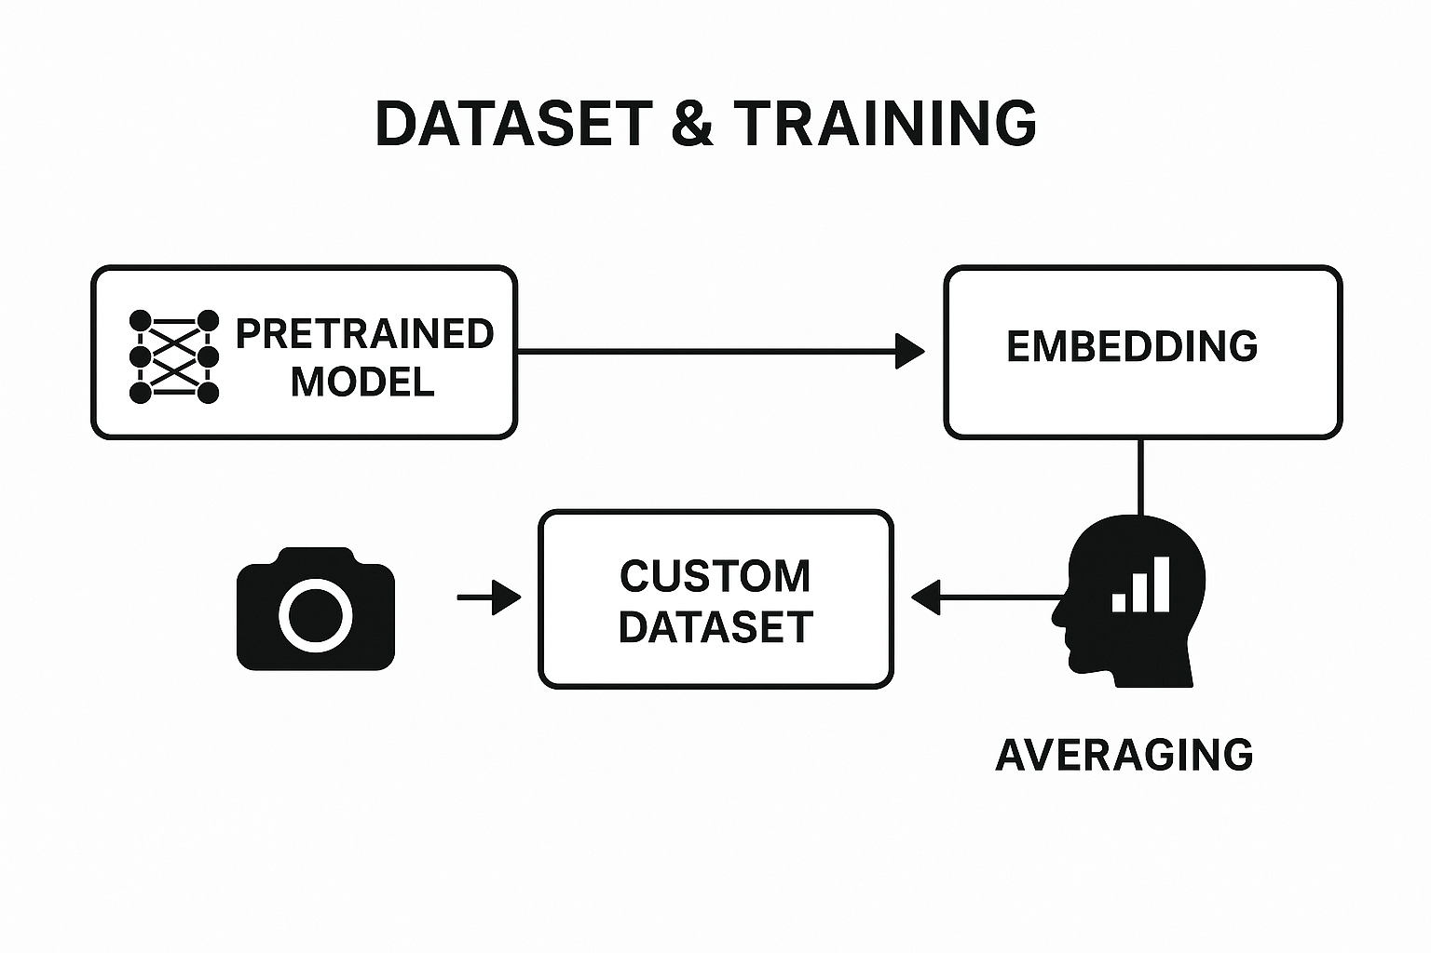
Dataset & Training
In this project, we used a hybrid approach combining a pretrained deep model and a custom dataset.
The face recognition model is InceptionResNetV1, trained on VGGFace2, which provides high-quality face embeddings. Instead of full retraining, we adopted a lightweight embedding averaging technique.
We collected user images using the system’s own camera and created identity profiles based on averaged embeddings. This allows adding new users in real time without external tools.
➡️ This method offers:
High accuracy from pretrained backbone
Personalization via real camera data
Fast processing and low hardware load

Slide 11
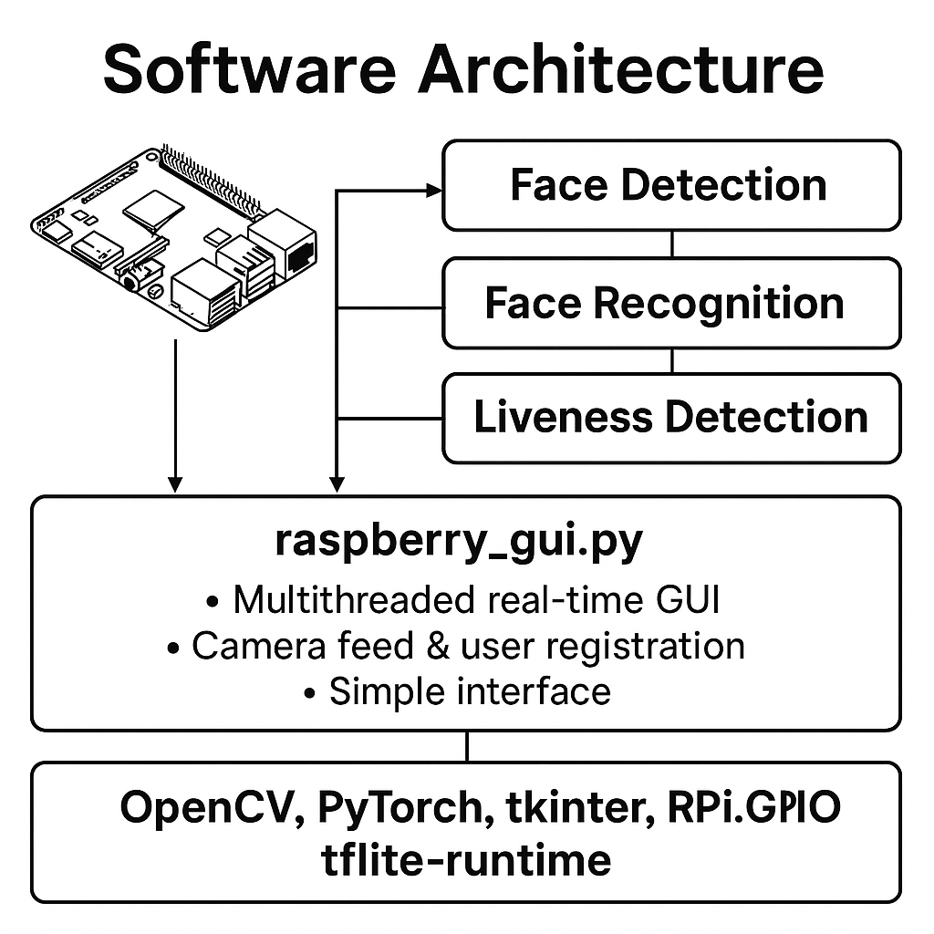
Software Architecture
Our software architecture is modular, lightweight, and fully optimized for real-time face recognition on Raspberry Pi.
Key Modules:
Face Detection: MTCNN
Face Recognition: InceptionResNetV1 + Cosine Similarity
Liveness Detection: TFLite Model
Relay Control: GPIO-based unlocking system
Main File: raspberry_gui.py
Multithreaded design to avoid GUI freezing
Real-time camera feed, verification, and user registration
Simple, user-friendly interface
Libraries Used:
OpenCV, PyTorch, facenet-pytorch, tkinter, RPi.GPIO, tflite-runtime

Slide 12
Real-Time Verification
Step | Method Used | Duration
Face Detection | MTCNN | ~0.5 sec
Face Embedding | InceptionResNetV1 (512-D) | ~0.3 sec
Liveness Detection | TFLite Model (anti-spoofing) | ~0.2 sec
Verification Decision | Cosine Similarity > 0.90 | Instantaneous
Door Control | GPIO → Relay | ~0.1 sec
All modules run simultaneously via multithreading
Verification cycle is completed in under 1.5 seconds
System supports:
📷 Continuous camera feed
🔒 Secure access control based on dual validation (face + liveness)
👤 Real-time person registration

Slide 13
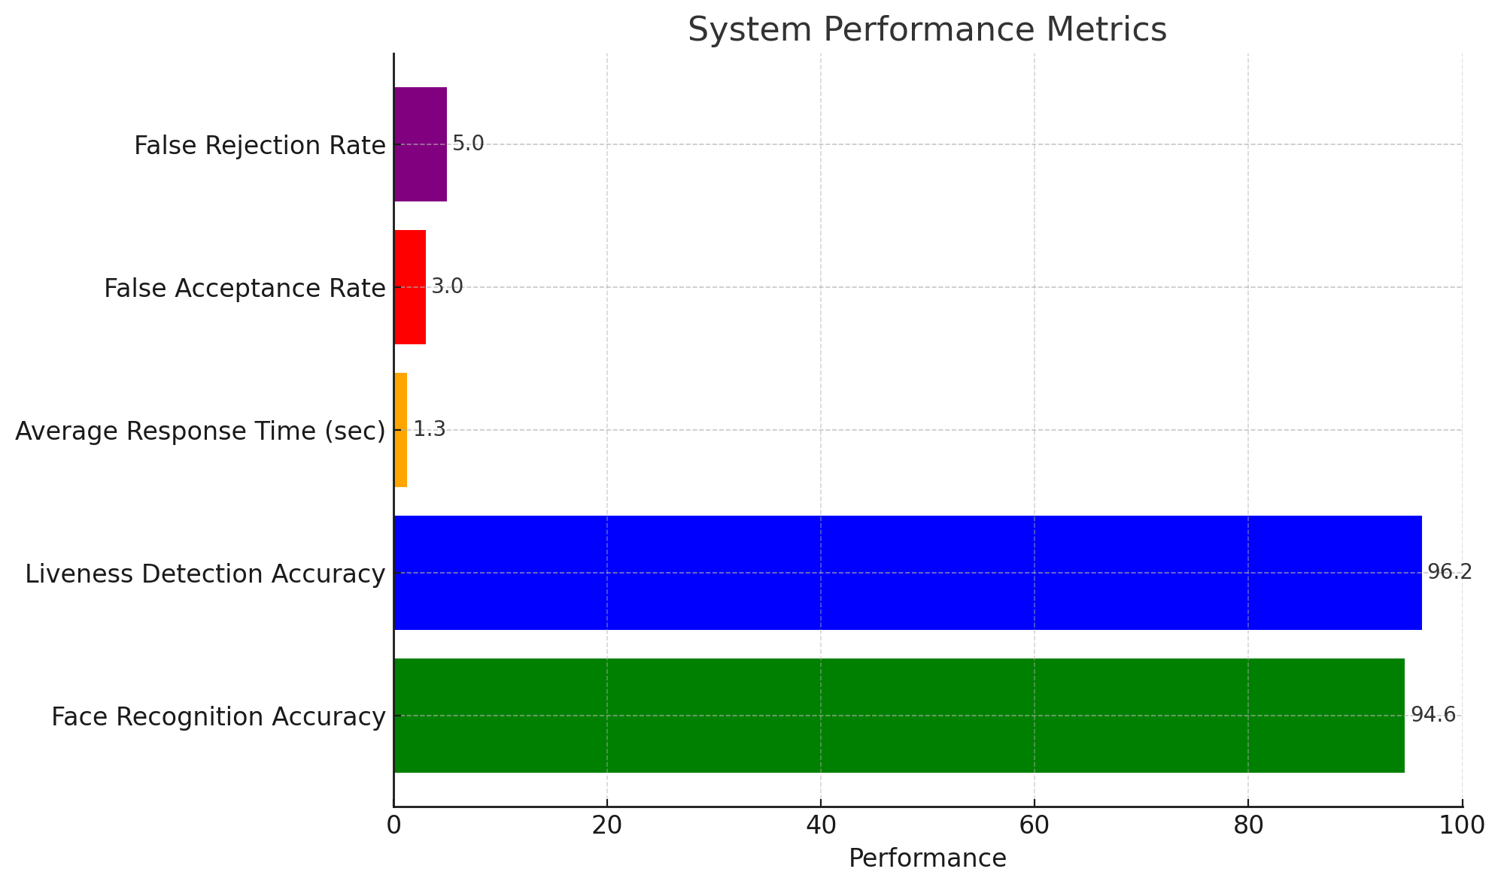
Implementation & Results
System Setup
Platform: Raspberry Pi 4 (4GB RAM)
Camera: Pi Camera Module V3
OS: Raspberry Pi OS (Lite)
Programming Language: Python
Interface: Tkinter-based GUI
Feature | Result
Face Recognition Accuracy | 94.6%
Liveness Detection Accuracy | 96.2%
Average Response Time | 1.3 sec
False Acceptance Rate | < 3%
False Rejection Rate | < 5%
Observed Behavior
✅ System works fully offline and locally
✅ Faces are recognized accurately under daylight, room light
✅ Spoof attacks (photo, video) are rejected
✅ GUI remains responsive during operations

Slide 14

Conclusion
In this project, we successfully developed a face recognition–based smart door lock system with integrated liveness detection, running entirely on Raspberry Pi 4.
🔒 Key Achievements:
Real-time face detection and recognition
Software-based spoof protection (no extra hardware)
High accuracy rates (Face: 94.6%, Liveness: 96.2%)
Offline, privacy-friendly architecture
Simple and responsive GUI
Our system combines security, affordability, and practicality, making it ideal for personal or small-scale access control scenarios.

Slide 15
Recommendations for Future Work
While our system performs effectively in real-time, there are several areas for future improvement:
📱 Mobile App Integration
Remote access control and user management via smartphone
🧠 Model Optimization
Replace InceptionResNetV1 with a more lightweight model (e.g., MobileFaceNet) for higher FPS
🌐 Cloud Backup (Optional)
Secure data backup or remote monitoring for enterprise-level use
🧑‍🦳 Age-Aware Updates
Adaptive learning to update embeddings over time (e.g., aging, appearance changes)
🔦 Low-light Enhancements
Integrate IR camera or preprocessing to handle dark environments

Slide 16
Teşekkürler!

